Slide 1

Random Forest

Slide 2
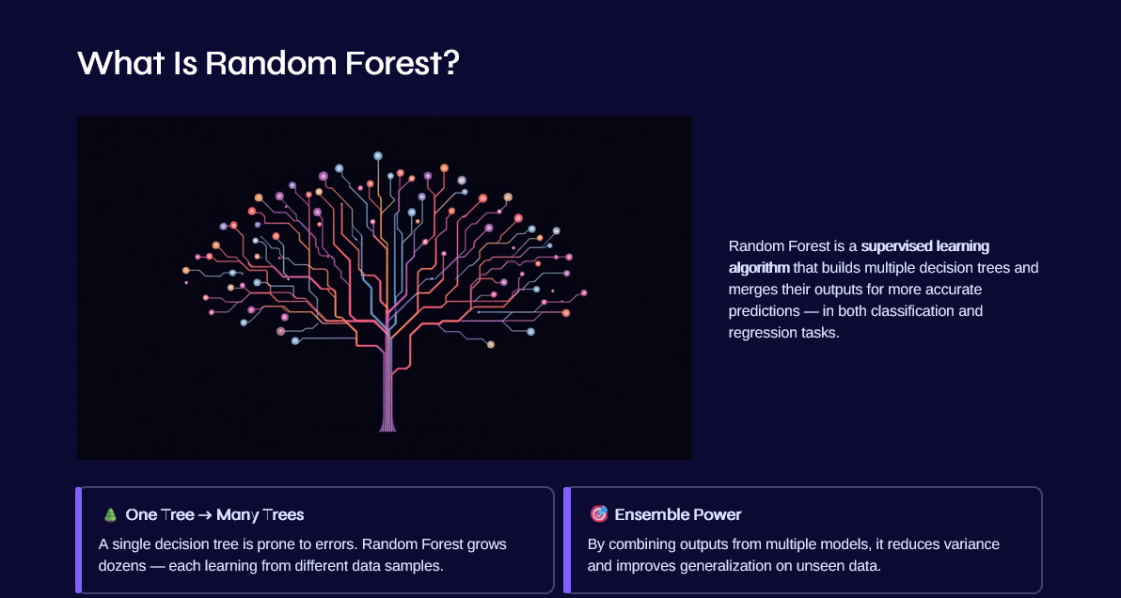

Slide 3
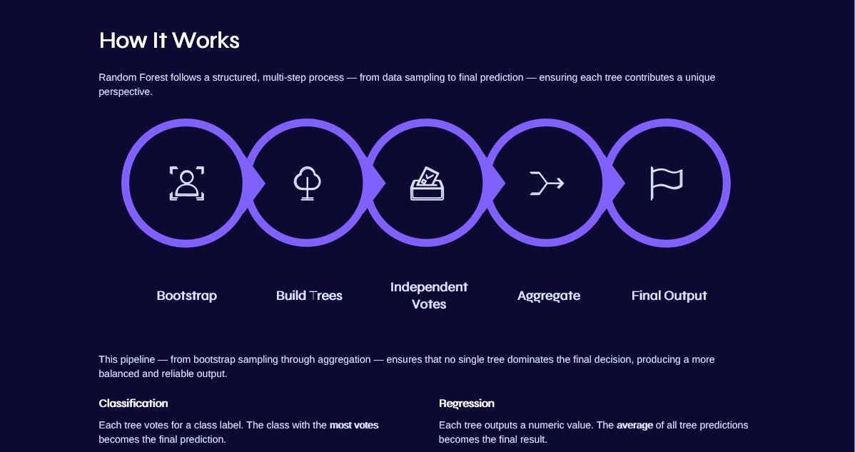

Slide 4

Why Random Forest Is Powerful
Ensemble Learning
Combines many weak learners into one strong, reliable model.
Reduces Overfitting
Multiple trees on random samples prevent memorization of training data.
Handles Complex Data
Scales well with large datasets, high dimensionality, and mixed feature types.
Robust to Noise
Tolerates missing values and outliers without significant performance loss.

Slide 5


Slide 6


Key Takeaways
1
Ensemble = Strength
Combining many decision trees outperforms any single tree in accuracy and stability.
2
Built-In Error Control
Bootstrap sampling and random feature selection naturally reduce overfitting.
3
Versatile & Practical
From healthcare to finance, Random Forest solves real-world problems at scale.
4
A Foundation for Advanced ML
Understanding Random Forest opens the door to Gradient Boosting, XGBoost, and modern ensemble methods.
Remember: Random Forest is not just an algorithm — it's a mindset. Diversity in models leads to smarter decisions.

